Slide 1
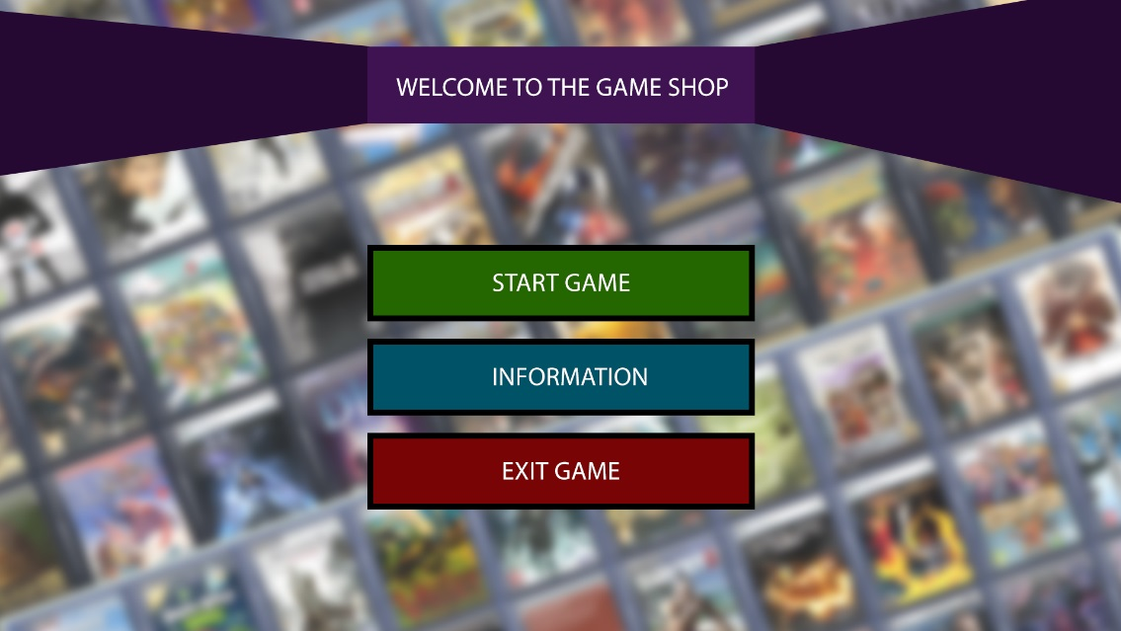

Slide 2
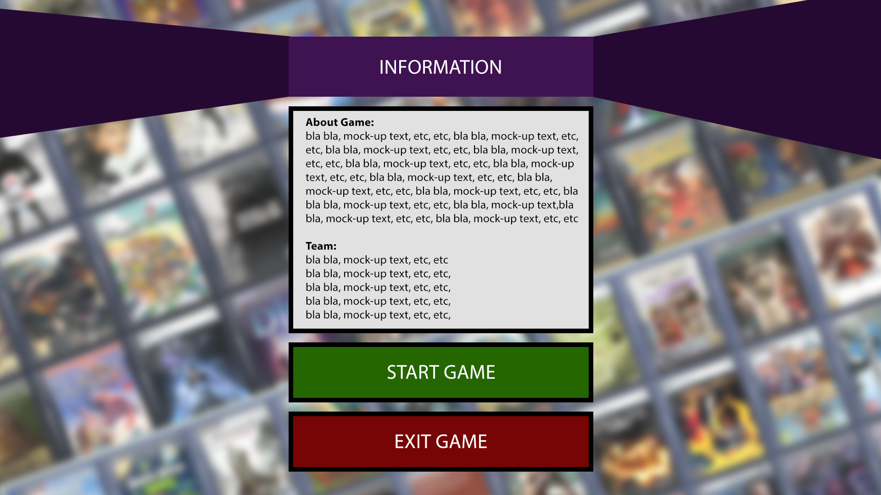
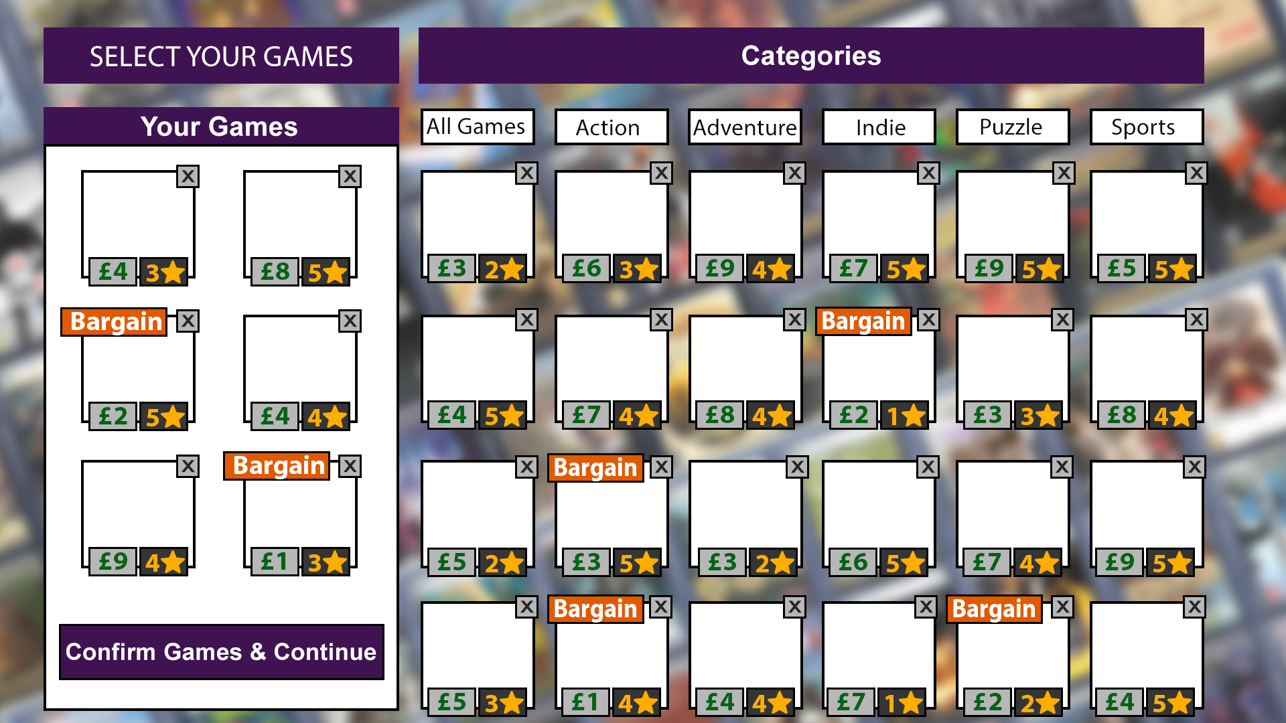
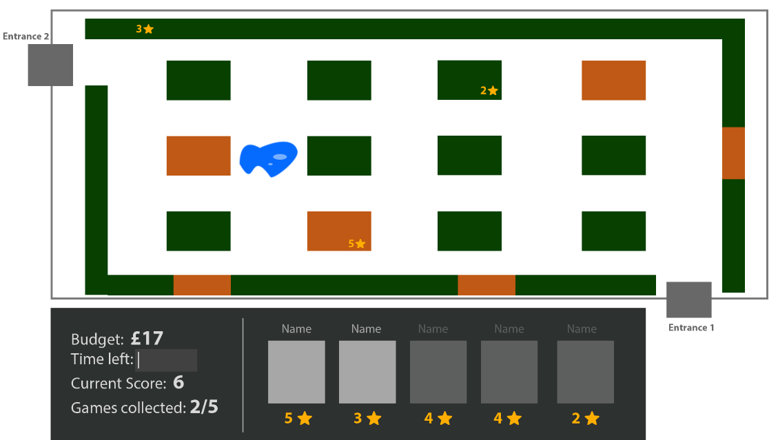
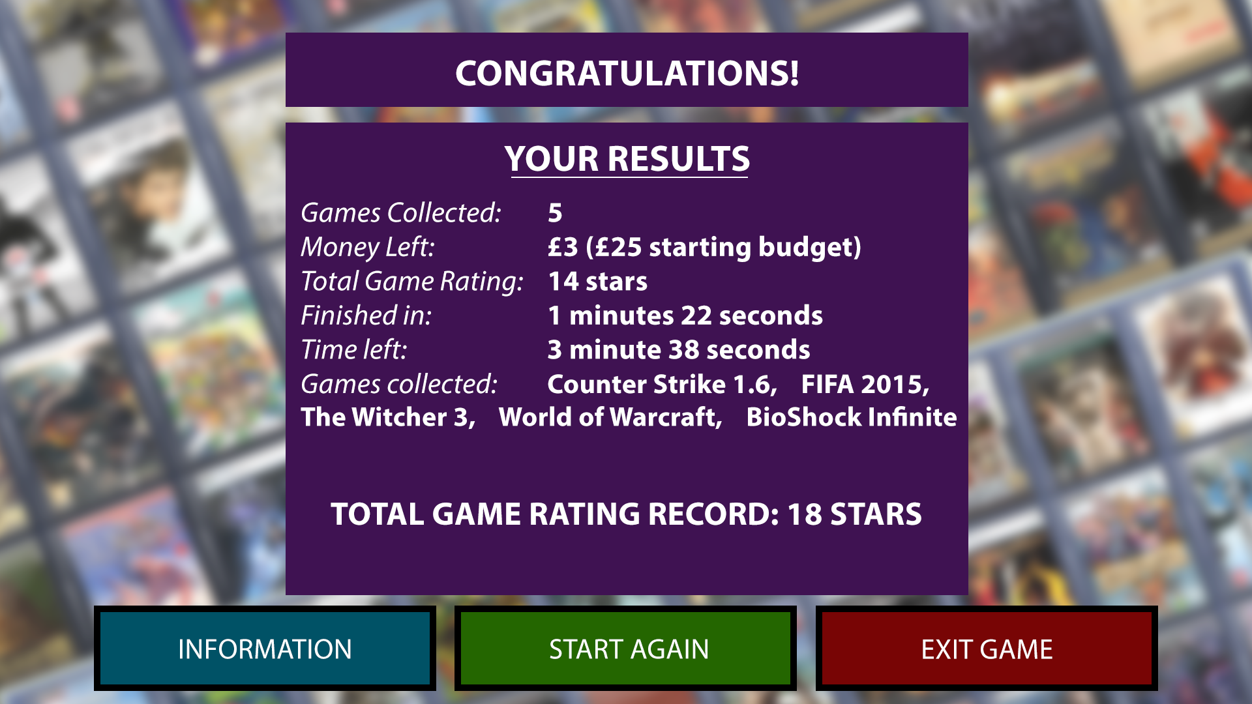

Slide 3
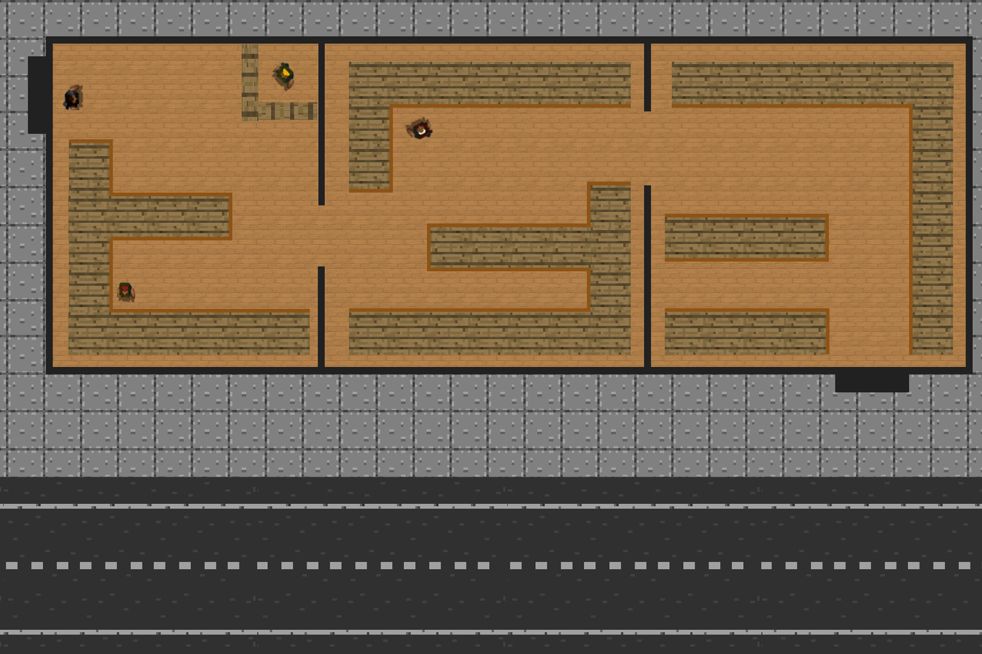


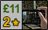

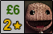
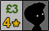

Slide 4
Things we achieved as a group:
Demo version of the game…for now
Story board
Uml diagram
Flow chart
Did the researches on algorithms

Slide 5
What we learned from working as a group:
Improved teamwork skills
Improved communication skills
Gained knowledge in IT resources available for project management and communication
Improved task delegation
Gained knowledge in user experience and usability

Slide 6
What we learned from working as a group:
Gained knowledge in GUI programming using kTinker
Learned how to create story boards and UML diagrams
Improved time management skills
Learned using Git - source code management system

Slide 7
Problems we encountered(with solutions):
Lack of knowledge in required topics – further research into the topics
Bad time management – allocating more time towards each task
Lack of communication - making more use of social networks
Misunderstanding of the task – explaining he task to the group, making sure everyone has a complete understanding of the task
Unrealistic goals – setting achievable goals
Bad task management – reassign tasks

Slide 8
GUI widgets used:
Buttons
Labels
Radio buttons
Canvas
Frames
Text
Images
Check box
Spinbox

Slide 9
Algorithms used:
A * algorithm for path finding
Binary search algorithm for checking if list contains a required object/item
Shell sort
Merge sort
Quick sort

